Slide 1
R-Values and Move Semantics in C++
David Sackstein

Slide 2
Agenda
What is a reference?
L-Value and R-Value
Const and references
R-Value reference
Overloading by reference type
The need to move (instead of copy)
Putting it all together with Move Semantics

Slide 3
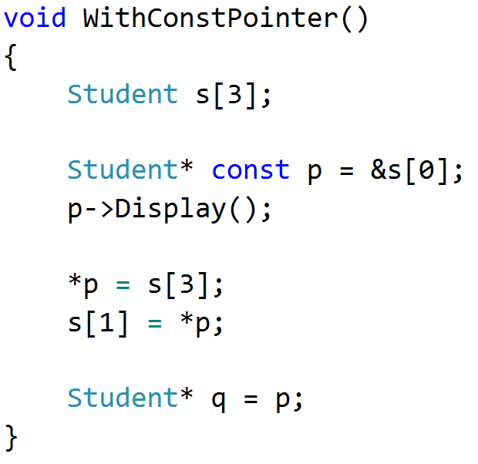
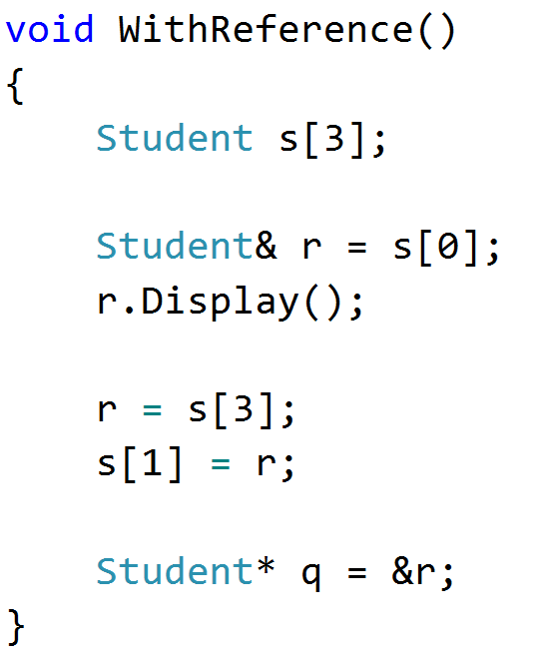
What is a reference?
An automatically dereferenced const pointer.

Slide 4
L-value and R-value
Position
An l-value can appear on the left or right side of an assignment
An r-value can appear on the right only
Name
An l-value has a name (an address)
An r-value has no name
Implicit temporaries are r-values

Slide 5
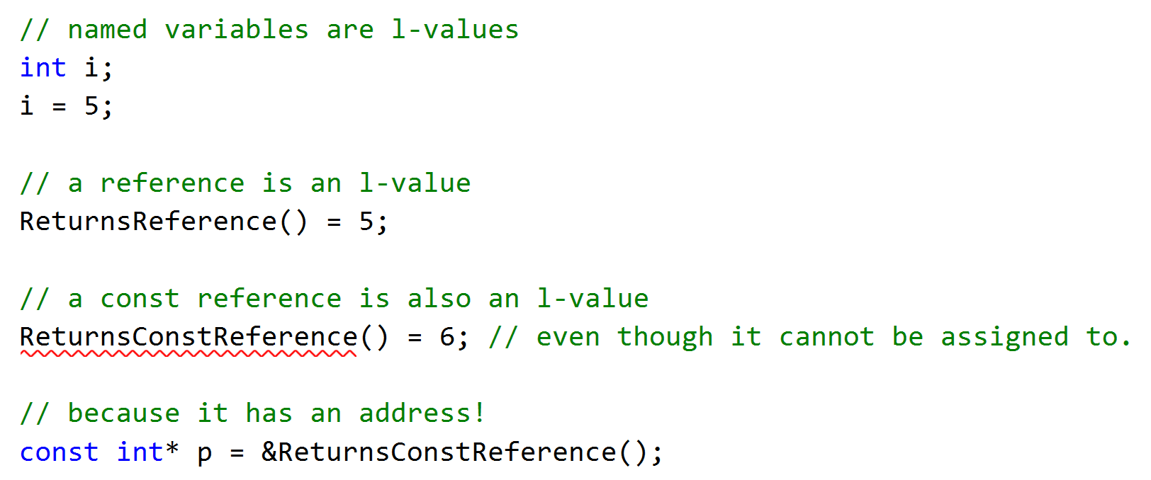
L-value Examples

Slide 6
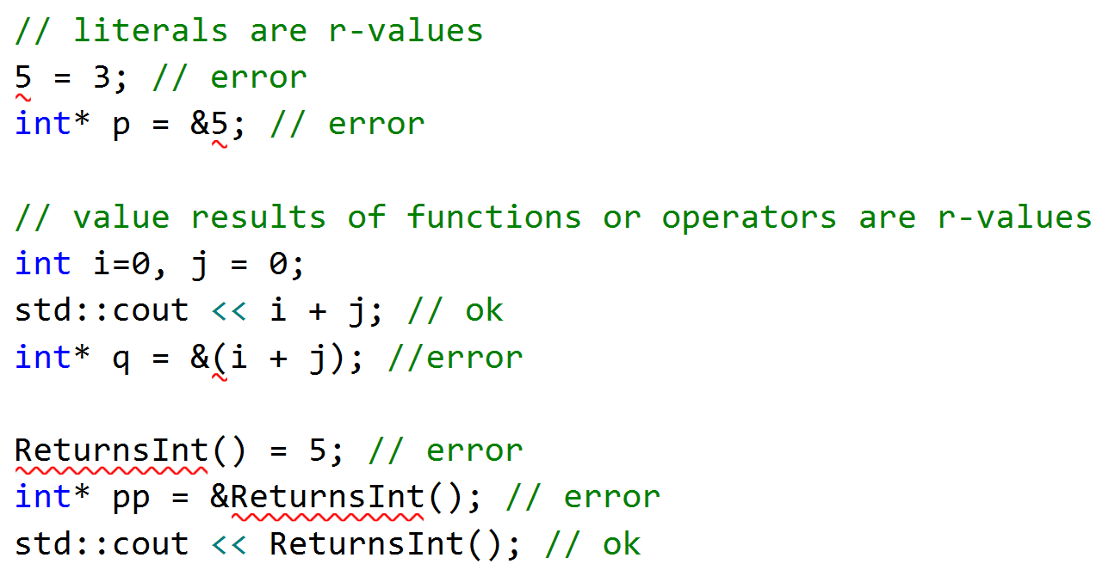
R-value Examples

Slide 7
const and references
l-values can be bound to:
A reference
A const reference
r-values can only be bound to:
A const reference.
This difference ensures that developers cannot modify temporaries.
Binding an r-value to a reference extends its lifetime

Slide 8
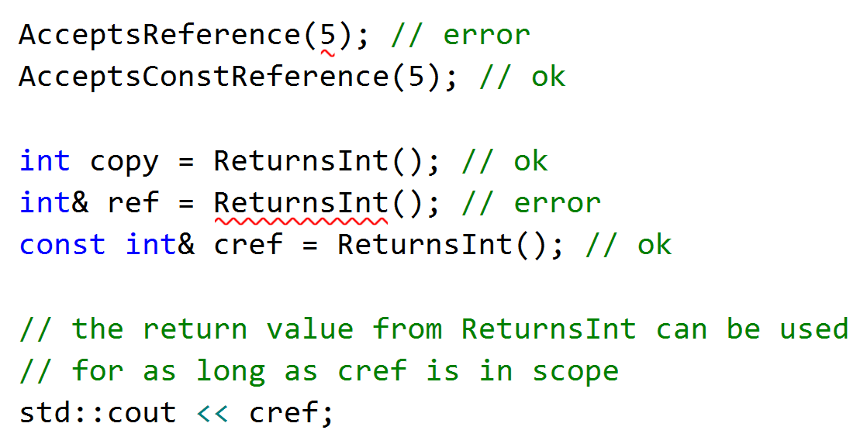
const and reference examples

Slide 9

R-Value Reference
R-Value references are a new reference type.
Notation is:
R-Value references:
Can bind to r-values
Cannot bind to l-values
The existing reference type is now called
L-Value reference

Slide 10
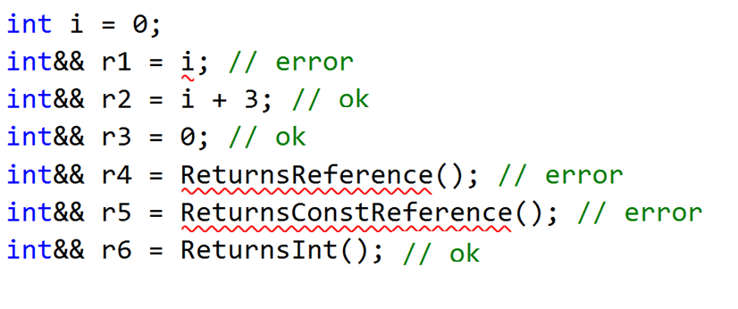
R-Value Reference examples

Slide 11
Overloading by reference type
Functions can be overloaded by reference type.
When both types exist:
L-Value binds to the overload with L-Value reference
R-Value binds to the overload with R-Value reference

Slide 12
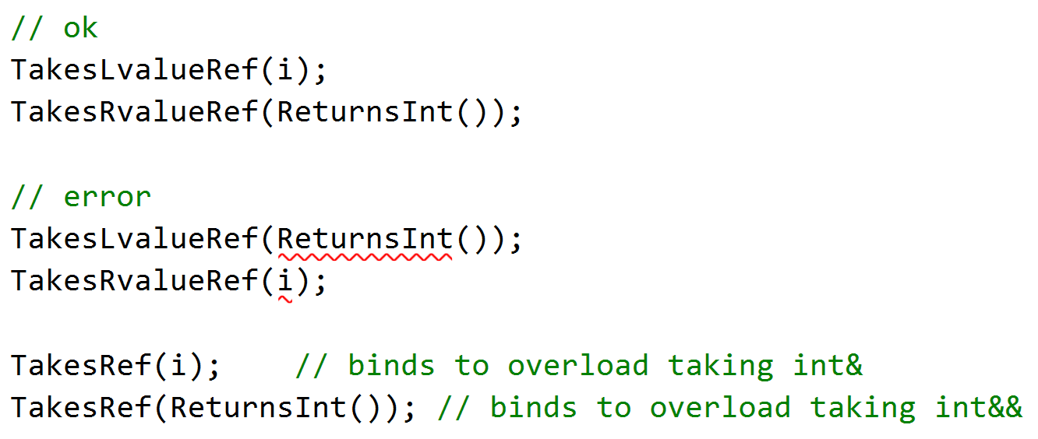
Overloading examples

Slide 13
The Need to Move
When assigning from f() that returns by value:
You copy return value to temporary (r-value)
Assign temporary to target
Destroy temporary
Expensive if the type contains a resource.
We would prefer:
Move resource from to target
Destroy empty temporary

Slide 14
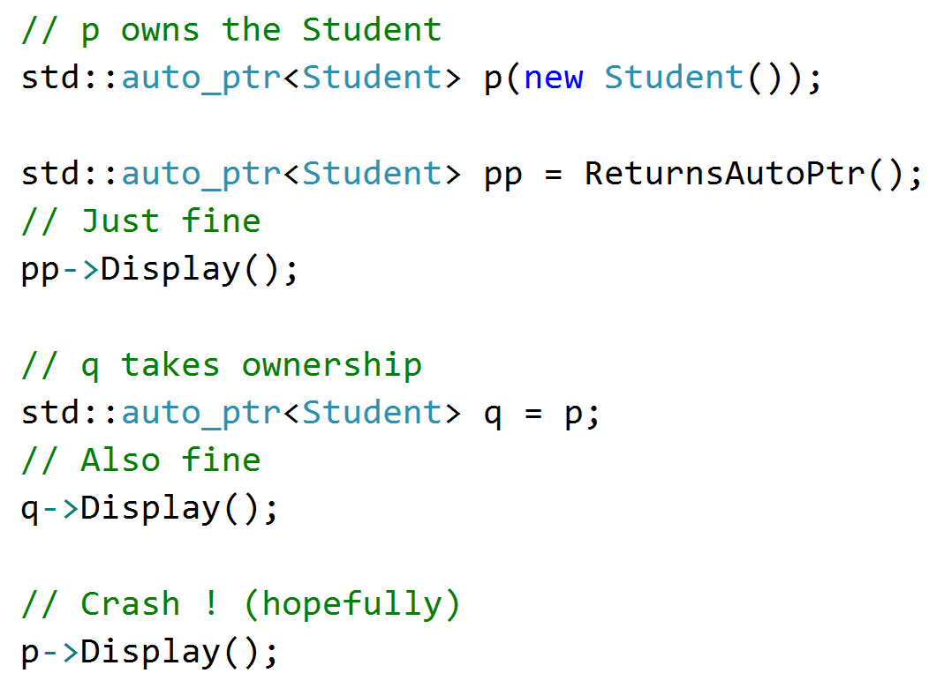
But is moving always safe?
An iconic example of ‘unsafe’ moving

Slide 15
Solution
It is safe to move a resource if that resource might not be used again before being destroyed.
How can you tell that it will not be used again?
If it has no name!
If it is a temporary!

Slide 16
Putting It All Together
Provide two constructors overloaded by reference type
One accepts a L-Value reference
This the good old copy constructor
Make it a const reference because it only copies
It leaves the source intact.
One accepts an R-Value reference
This will safely move the resource from the source
This will be called a move constructor

Slide 17
Putting It All Together
The compiler applies the rules:
When you construct an object from a temporary, the move constructor will be called
When you construct an object from an l-value, the copy constructor will be called
You can also overload the assignment operator:
The compiler will select the right one depending on whether the source is an R-Value or an L-Value

Slide 18
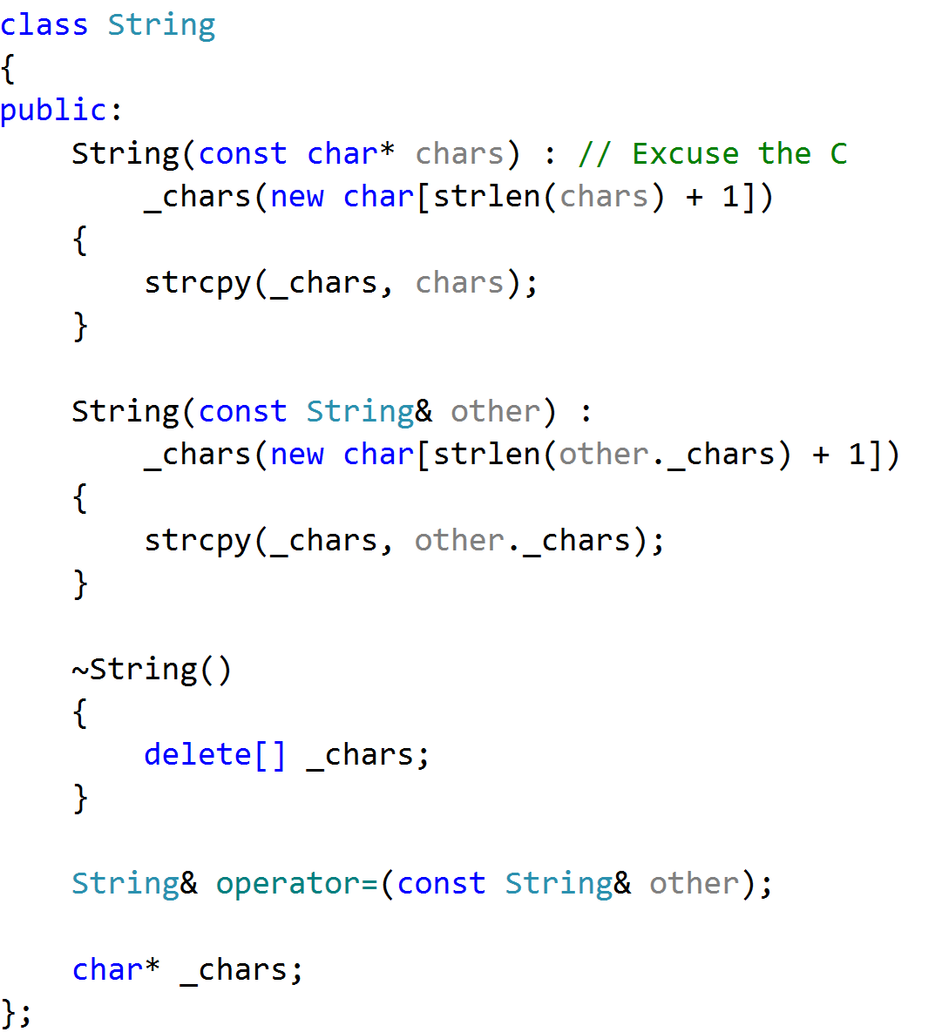
Example
String has a resource
It manages it in its:
Copy constructor
Assignment operator
Destructor.
This is The Rule of Three

Slide 19
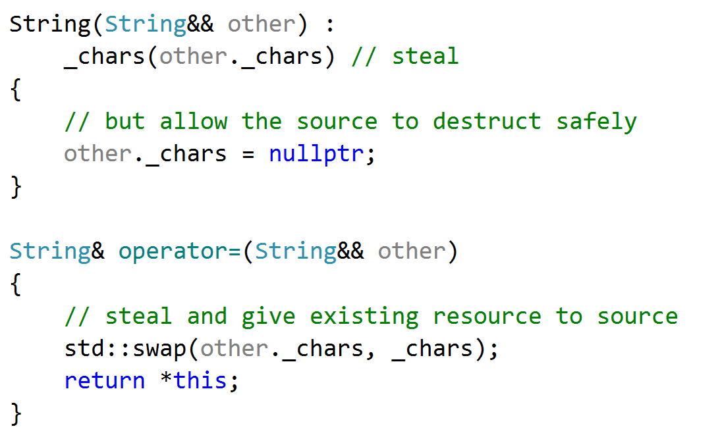
Adding Move Semantics

Slide 20
Good Practice
Move semantics makes returning by value and passing by value fast.
It is now recommended to apply the Rule of Five for classes that manage resources:
Copy Constructor
Copy Assignment Operator
Destructor
Move Constructor
Move Assignment Operator

Slide 21
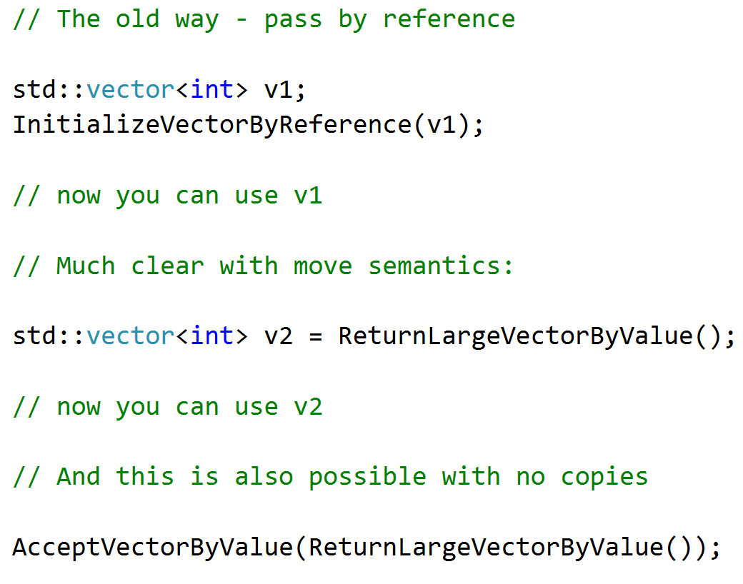
Was it worth it?
Move semantics have been implemented for all containers in the STL.
So the following are fast and more expressive:

Slide 22
Question?
How would you fix auto_ptr ? (See Slide 14)

